Slide 1

E-Commerce Pulse: Integrated Performance Analytics
TK
by Tushar Kshirsagar

Slide 2

E-commerce Performance Overview
1
Total Revenue
$69.5M in total revenue indicates strong sales performance, reflecting the overall success of the e-commerce platform in driving sales across various product categories.
2
Total Orders
50.0K total orders suggest a high level of customer engagement and consistent demand, showcasing the platform's ability to attract and retain customers.
3
Average Order Value
$1.4K average order value highlights the significant spending power of customers, implying that the platform is effectively upselling or that customers are purchasing high-value items.

Slide 3
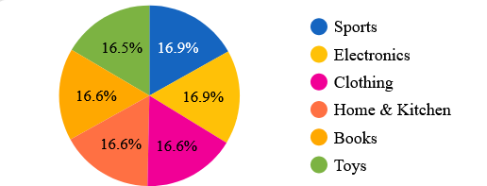
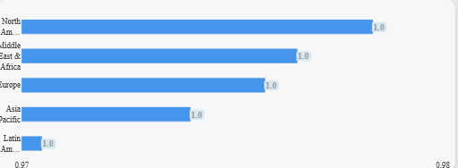
Customer Segmentation and Sales Distribution
The balanced customer distribution across Home Office (25.2%), Small Business (25.2%), Corporate (24.9%), and Consumer (24.7%) segments demonstrates diversified market appeal, minimizing reliance on any one segment and enhancing business stability.
Customer Segment Distribution
North America dominates sales across product categories, followed by the Middle East & Africa and Europe, signaling robust market penetration and highlighting growth opportunities in underperforming regions like Latin America
Sales by Product Category

Slide 4
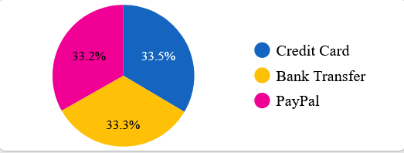
Order and Payment Analysis
Average Orders per Customer
The data reflects robust customer loyalty, as evidenced by an average of 10 orders per customer. This indicates a high level of customer satisfaction and repeat business.
Average Shipping Cost
A balanced distribution across payment methods Credit Card, Bank Transfer, and PayPal at 33% each enhances customer convenience, supporting high order frequency.
Order Distribution by Payment Method
The pie chart to understand the proportion of orders by each payment method, highlighting key payment trends and opportunities for optimizing payment processing and related customer experience
Average Order Value
Average shipping costs of $27.5 and a shipping time of 14.5 units reflect effective cost and delivery management.

Slide 5
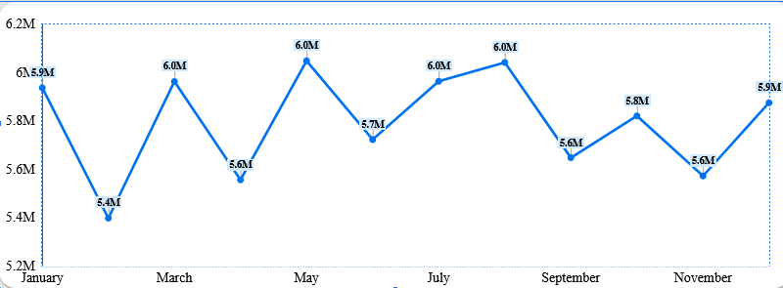
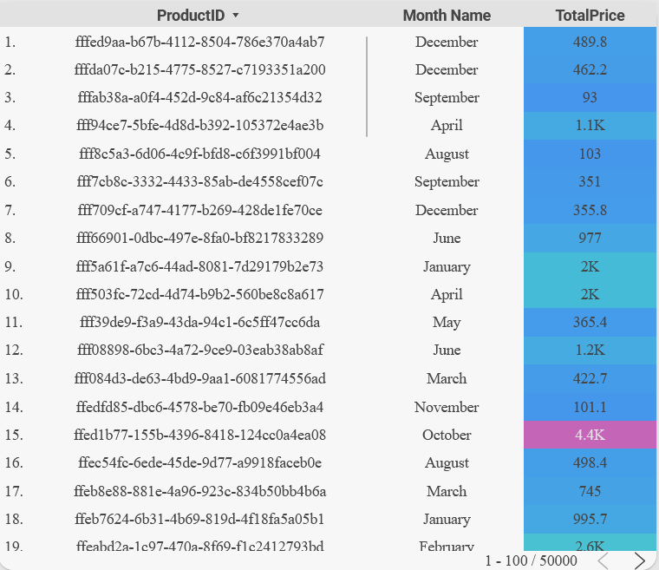
Sales Trends and Seasonality
The chart reveals stable overall performance with minor fluctuations, showcasing peak sales in July and troughs in February, suggesting potential seasonal patterns impacting sales volume
Monthly sales trend
December's top sellers highlight key products, informing year-round inventory and marketing strategies.
Seasonal product performance

Slide 6

Key Insights
1
Strong Overall Performance
2
Geographic Expansion
Potential growth in Latin America.
Balanced customer segments indicate stable business health.
3
High Customer Loyalty
4
Logistics Optimization
Repeat orders highlight customer satisfaction.
Opportunities to reduce shipping costs and times.
5
Seasonal Trends
Clear patterns for guiding inventory and marketing strategies.

Slide 7

Recommendations
1
Market Expansion
2
Logistics Optimization
Focus on increasing market share in underperforming regions.
Implement strategies to lower shipping costs and improve delivery times.
3
Targeted Marketing
4
Increase Order Value
Develop and execute campaigns tailored to seasonal demand peaks.
Explore initiatives to increase average order value.

Slide 8

Thank You

